Slide 1
Boosting Innovation and Economic Development
Taiwan’s Strategies and Achievements
Mei-Hua Wang
Vice-Minister
Ministry of Economic Affairs
November 23, 2017

Slide 2
Outline
1. Status of Innovation in Taiwan
2. Taiwan Innovation Policy and Strategies
3. Conclusion

Slide 3
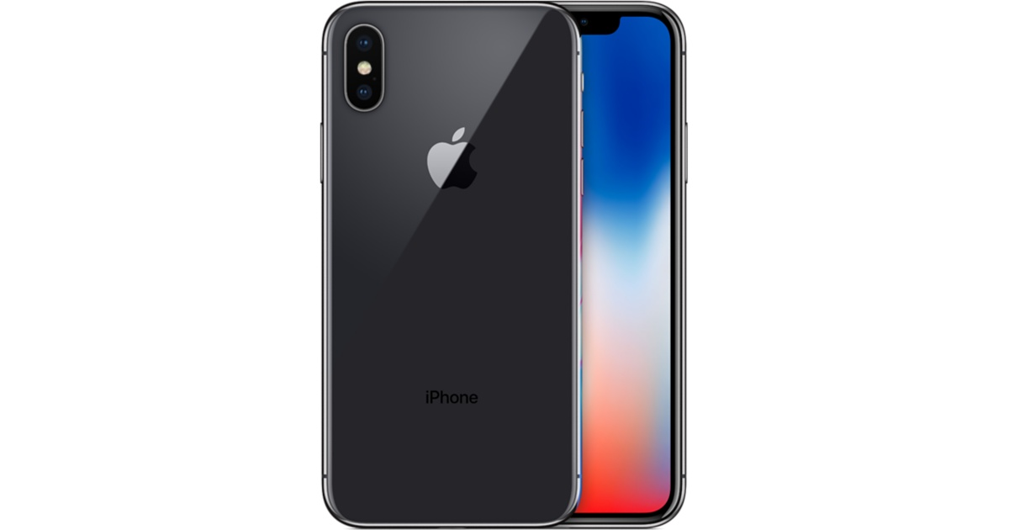
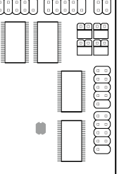
Taiwan’s important role in iPhone supply chain
Largan 大立光 Lens Module
A11 Chip TSMC
TSMC
+
ASE Group日月光 SPIL矽品 KYEC京元電
+
Qualcomm, Intel, Broadcom, Texas Instruments
Wireless Communication Transceiver Module
Near-field wireless communication chip
Wireless charging IC
Foxconn 鴻海 Assembling
FLEXium 台郡 Zhen Ding Texh臻鼎
Flexible Print Circuit
CPMPEQ華通 Unitech 耀華 Kinsus景碩 Career嘉聯益
PCB
Notes:
The chip inside the iPhone X and iPhone 8 makes them more powerful
軟板(Flexible Print Circuit；FPC)

Slide 4
Taiwan's strong position in the global semiconductor market
Taiwan semiconductor industry production (2017f): US$80.5 billion
World No.2
World No.1
World No. 5
World No. 1
20.8%
72.5%
1.8%
55.5%
IC Design
Foundry
IDM (Memory)
IC Packaging & Testing
Mediatek
Realtek
Novatek
TSMC
UMC
MXIC
Winbond
Nanya
ASE Group
SPIL
KYEC

Slide 5
A Brighter Future with I T applications driven by semiconductor and software integration
AR
VR
Collaborative Robot
AI
Drone
Smart Transportation
Smart Agriculture
Smart Logistics
Smart Health
Smart Devices
Self-Driving Car
Smart Energy
Smart Production
Sharing Economy
Robotic Servant
Smart Lighting
Community
Smart Government
People
Smart Home
Enterprises
Smart City

Slide 6
“5+2” industrial innovation program
GREEN ENERGY
Solar power
Wind power
Energy conservation
CIRCULAR ECONOMY
Recycling and converting
waste into useful resources
+
SMART MACHINERY
Smart technology
Smart logistics
Smart cities
ASIA SILICON VALLEY
IoT
AI
AR&VR
Self-Driving Vehicles
BIOMED
Smart healthcare
New drugs market
High-value medical materials
DEFENSE INDUSTRY
Aerospace
Shipbuilding
Cybersecurity
NEW AGRICULTURE
Organic farming
Leisure agriculture
Safe and healthy products
1-1
2-1

Slide 7
Innovation drives competitiveness. But what drives innovation?
Improvement of Investment Environment
Viable Entrepreneurial Development
Generous Support to SMEs
Attracting FDI
Recruitment of talents
Innovation-friendly regulations
Active private funding to start-ups
First-of-a-kind innovation in Asia
Challenge-driven innovation, testbeds & social pilot projects
Technology innovation capacity
International marketing network
Easy access to multiple funding sources
2-3

Slide 8
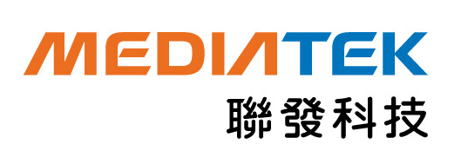
S&T Innovation Ecosystem-Hsinchu Science Park
Government
R&D Institutes
Universities
(ITRI)
Hsinchu
Science Park
Enterprises

Slide 9
Taiwan’s Competitiveness Ranking
14th
15th
Technological Infrastructure Factors in IMD 63 economies
1st | Singapore
2nd | Netherlands
3rd | Finland
4th | Mainland China
5th | Switzerland
6th | USA
15th | Taiwan
17th | South Korea
18th | Hong Kong
Scientific Infrastructure Factors in IMD 63 economies
1st | USA
2nd | Japan
3rd | Mainland China
4th | Israel
5th | Switzerland
8th | South Korea
10th | Taiwan
12th | Singapore
24th | Hong Kong
Innovation and sophistication Factors in WEF 137 economies
1st | Switzerland
2nd | USA
3rd | Germany
4th | Netherlands
6th | Japan
12th | Singapore
15th | Taiwan
18th | Hong Kong
23rd | South Korea
2-7

Slide 10
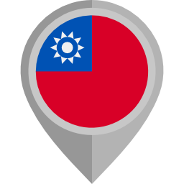
Conclusion
Linking Taiwan’s “5+2” innovative industries initiatives and Switzerland's "Industry 4.0" strategy
Enhancing bilateral innovation cooperation
Welcoming investment in Taiwan & engagement in technology cooperation

Slide 11
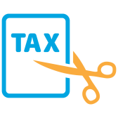
Statute for Industrial Innovation Act
Tax Deductions
Angel investors
Limited partnerships
Intangible Assets
Commercialization
Improving intangible assets evaluation to foster creative industries
Shares linked to technology transfer only taxed when transfer completed
Spur for Industrial Sector
State-run Enterprises
Levying fines for unused industrial land; auctioning off such property
Encouraging SOEs to engage in selective bidding for R&D procurement

Slide 12
Regulatory Sandbox
FINTECH
“Financial Technology Innovative Experimentation Act”： The first reading completed in early November
Allowing Fintech businesses to test services and exempt from restrictions up to 36 months - the longest trial period in the world
Maintaining the overall safety and soundness of the financial system
SMEs
Shortening the communication between the innovators and authority
Making the regulations more flexible to meet the need of new business model
Speeding up entrepreneurship development process

Slide 13
Strategies for Start-ups
Start-up Incubation
Policy Planning
Linking to global startup clusters
Establishing a support mechanism
for starting enterprises
Information
Technology
Financing
Providing guarantees to SMEs
Software application of technical& hardware expertise
One Town
One Product
Management Consulting
Strengthening SME management capabilities
Rapid commercialization

Slide 14
Incubation System in Taiwan
113
IPO Companies
8,000+
International Awards
Startups
13,000+
SMEs
140+
Incubators

